Slide 1

Teaching modeling using simulation and Tello drones

Slide 2
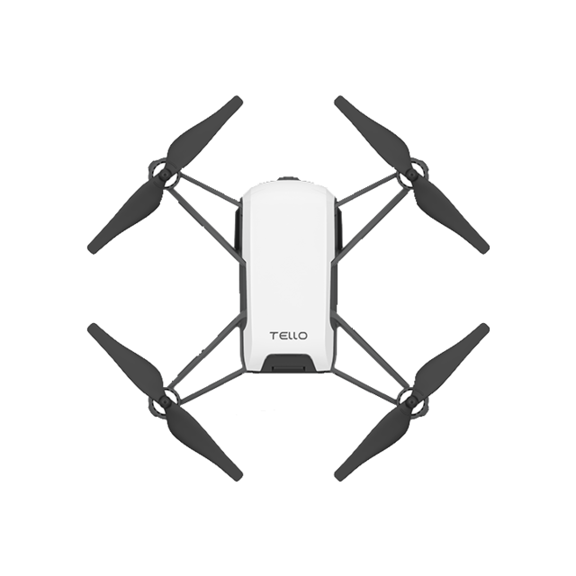
The tello_sim Python package is a simulator designed for use in classrooms using the Tello flight API

Slide 3
The package supports the Next Generation Science Standards related to “Developing and Using Models”.

Slide 4
Modeling in 6–8 builds on K–5 experiences and progresses to developing, using, and revising models to describe, test, and predict more abstract phenomena and design systems.
Evaluate limitations of a model for a proposed object or tool.
Develop or modify a model—based on evidence – to match what happens if a variable or component of a system is changed.
Use and/or develop a model of simple systems with uncertain and less predictable factors.
Develop and/or revise a model to show the relationships among variables, including those that are not observable but predict observable phenomena.
Develop and/or use a model to predict and/or describe phenomena.
Develop a model to describe unobservable mechanisms.
Develop and/or use a model to generate data to test ideas about phenomena in natural or designed systems, including those representing inputs and outputs, and those at unobservable scales.
https://ngss.nsta.org/Practices.aspx?id=2

Slide 5
A typical project can start with a drone course that is laid out in the classroom. Students then work together to develop a flight plan based on measuring the waypoints in the course.
Obstacles can be added to make the course more challenging.
The class and be divided into teams depending on the time you have and your instructional objectives.
landing
5
takeoff
1
2
3
4

Slide 6
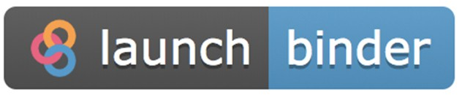
Using Python in a Jupyter Notebook
Jupyter Notebooks are a widely used tool for teaching programming. There are many resources including a dedicated book about using Jupyter Notebooks for education- https://jupyter4edu.github.io/jupyter-edu-book/index.html
The easiest way to use the tello_sim package in a classroom is to use the Launch Binder link on the tello_sim Github page- https://github.com/Fireline-Science/tello_sim

Slide 7
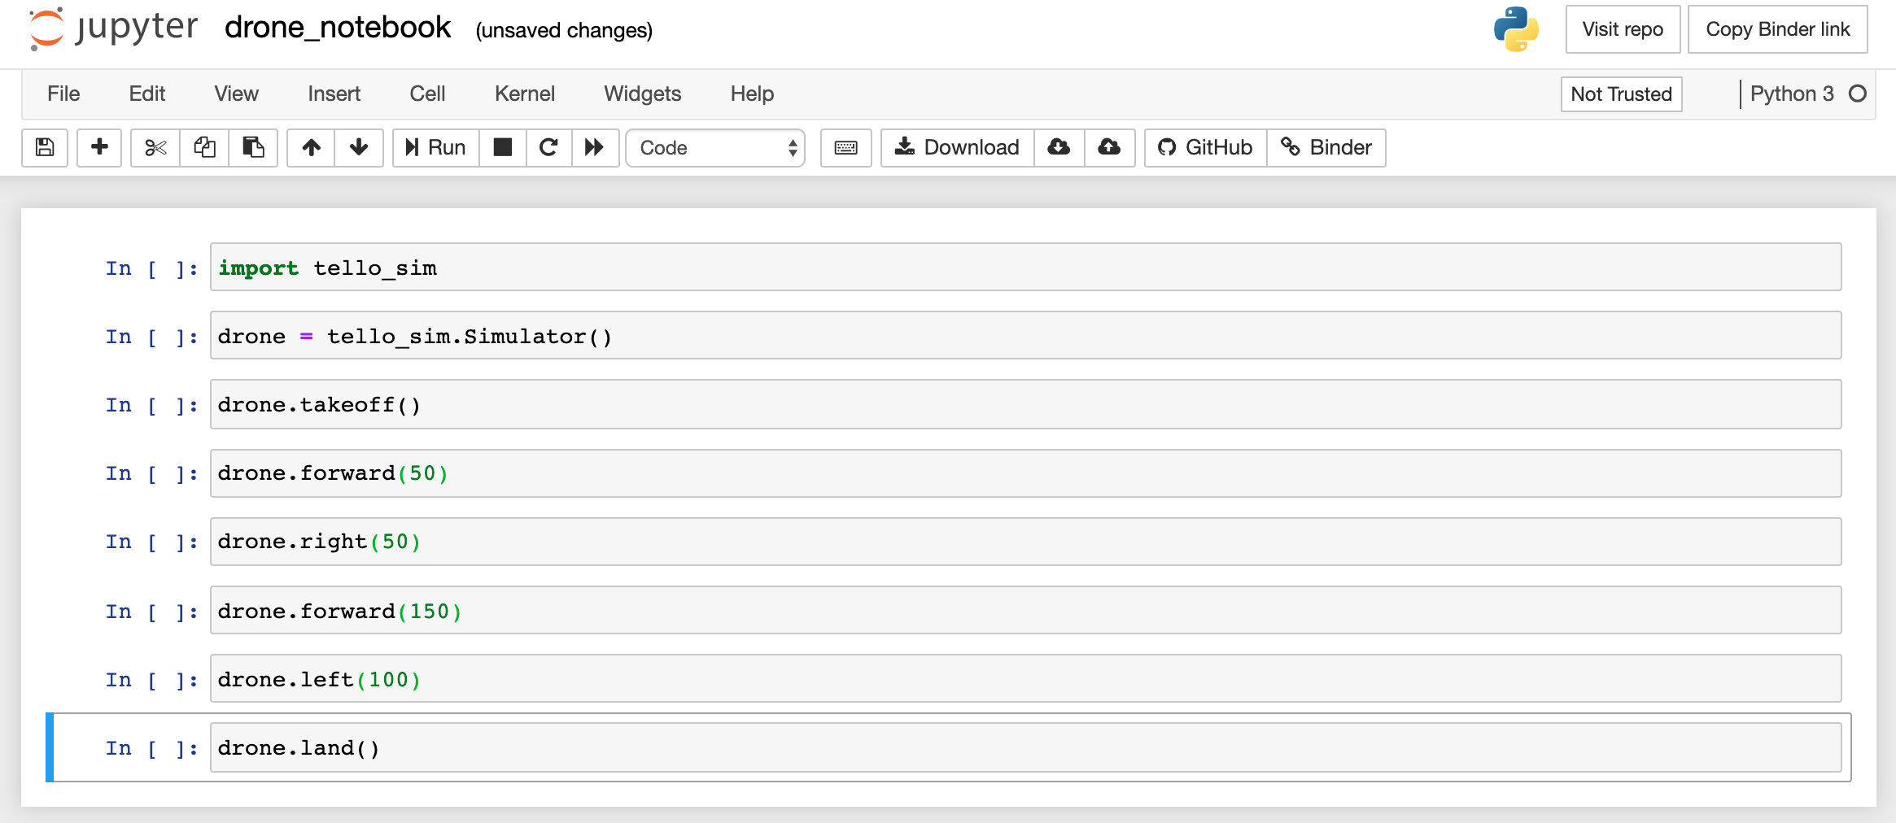
Once you have a launched Jupyter Notebook, students use their measurements of the course to create a programmed flight path. The flight path is entered into the simulation software using the Tello flight commands. There are many different options for a flight plan. In the program below, the altitude is not adjusted and the drone does not rotate.

Slide 8
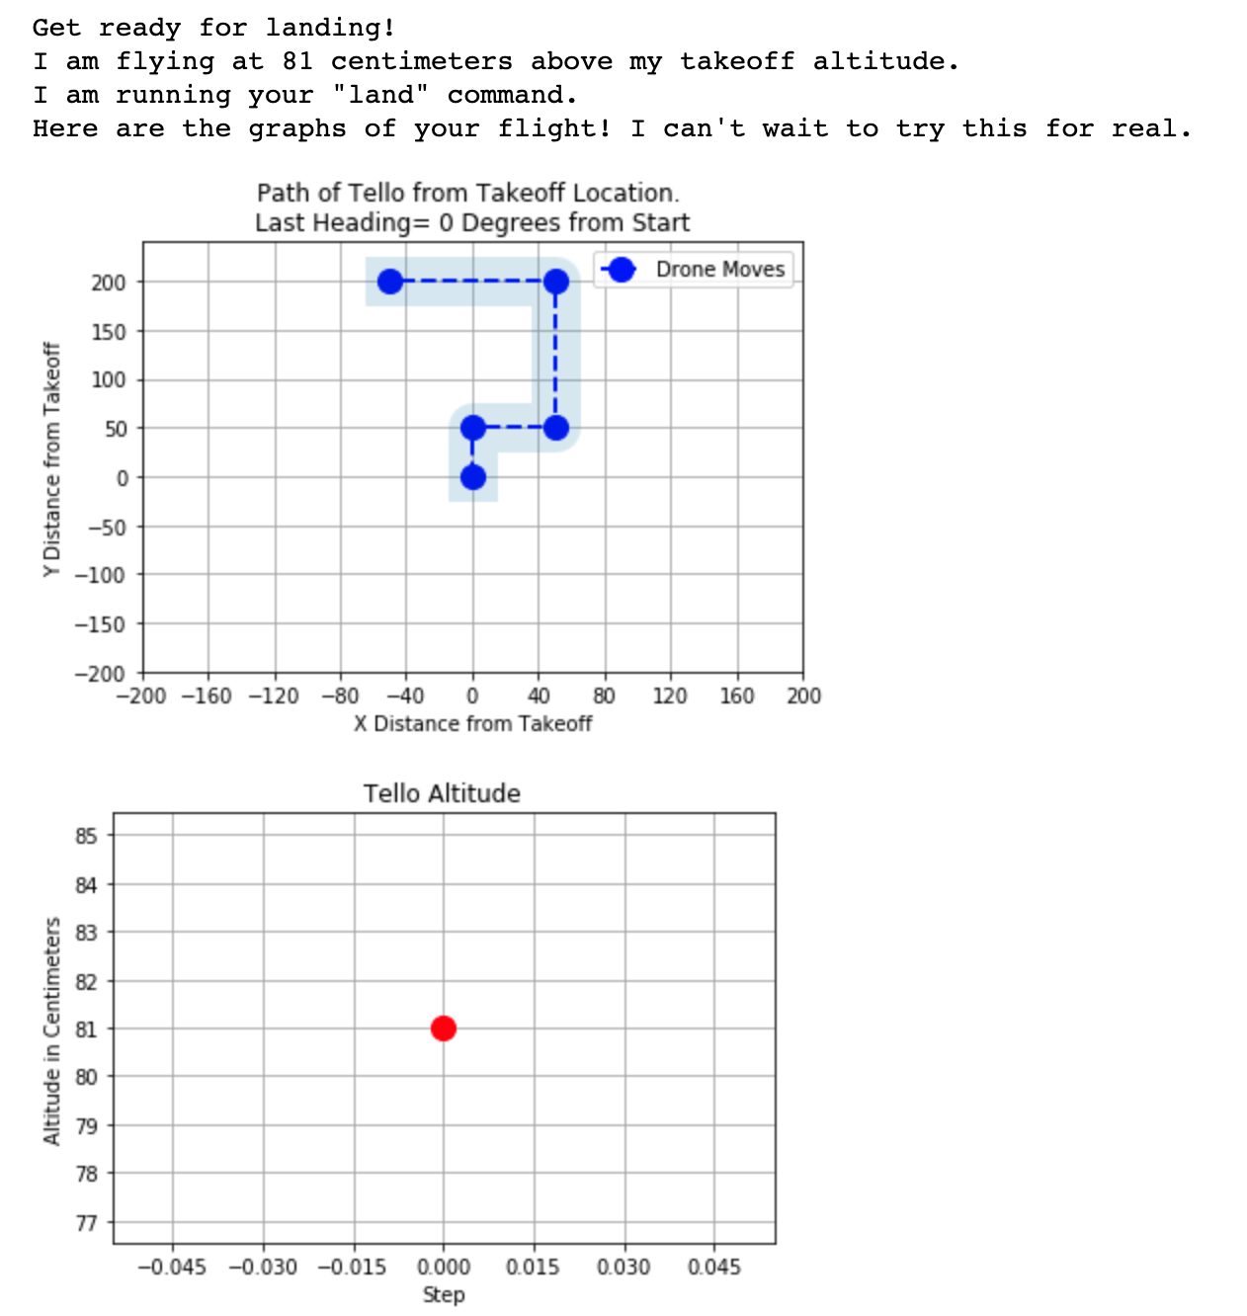
When the simulation is run, the program plots out each step of the program. The simulator also insures that the program syntax is correct and that flight rules are followed (e.g.- the “takeoff” command must be executed before any flight commands).

Slide 9
Simulated Path
A key learning objective is for students to understand the simulated flight is a computer model of how the drone might behave in the real world. The simulation allows students to see estimates of how their drone program will perform.
landing
50 cm
100 cm
takeoff
50 cm
150 cm

Slide 10
The model is tested when the program is deployed to the drone.
The actual flight will differ from the simulated flight depending on a variety of factors including:
The programmed flight path
Accuracy and precision of drone flight computer tracking
Environmental factors like wind
Obstacles not included in the model
Simulated Path
Actual Path
landing
50 cm
100 cm
takeoff
50 cm
150 cm

Slide 11
Deploying Programs to the Drone
If you want to control when the programs are deployed to the drone, you can require students to share their saved program using the drone.save(file_path='save_file.json') option in the Jupyter Notebook.
You can then load each students program using the drone.load_commands(file_path='new_commands.json') option. Details of this are available at https://github.com/Fireline-Science/tello_sim
You can also let students deploy their own programs as long as they are working with a computer that can connect to the drone WiFi.
If you have multiple drones, it is useful to write their WiFi network name on the drone to keep track of where you are connecting.

Slide 12
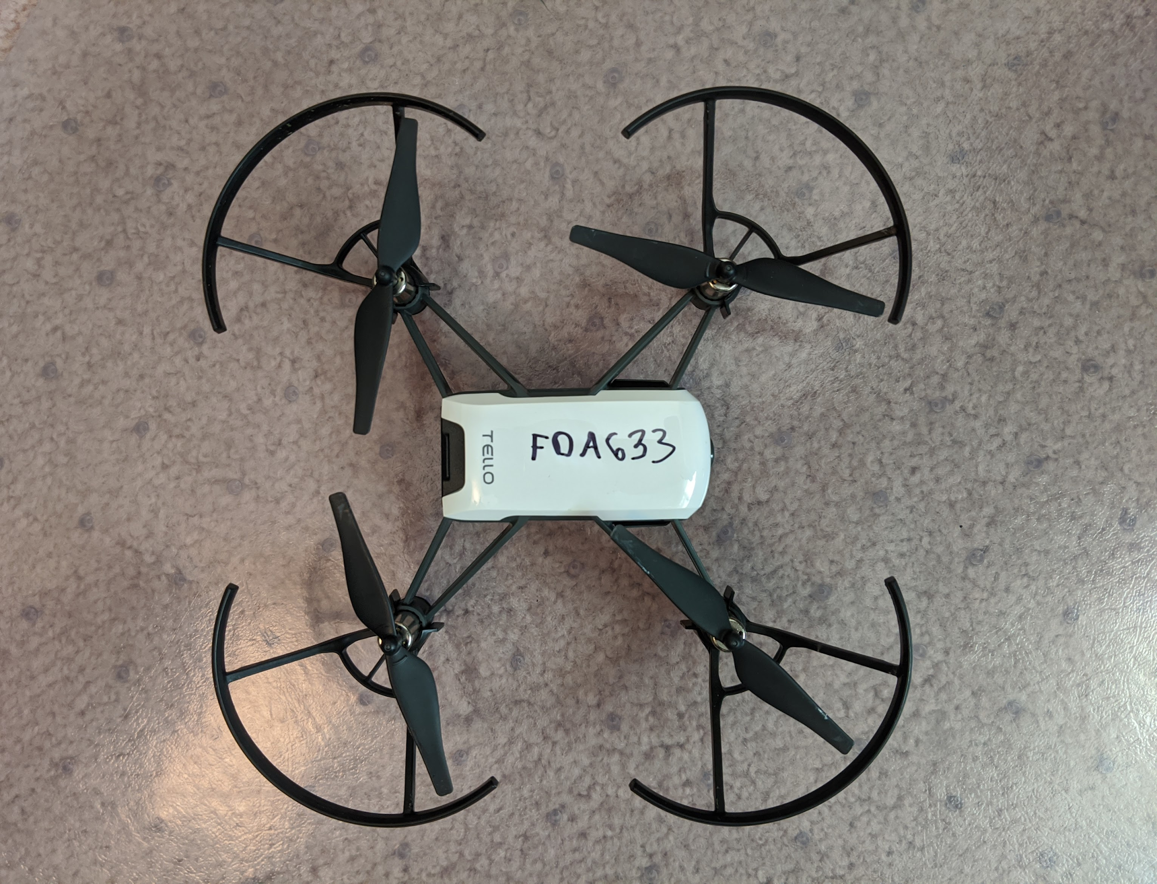
Each drone has a unique WiFi name that starts with “tello” and ends with a unique identifier.

Slide 13
After testing the simulated flight by flying the drone, students can discuss:
If the drone was flown multiple times, were there differences between the flights?
Why might there be differences between flights if the program remains the same?
How accurate was the simulated flight compared to the real one?
Where did the actual flight differ from the simulated flight?
What are some reasons for these differences?
How could the simulation be made more accurate?
How could the flight program be adjusted to better match the planned flight path?

Slide 14
The programmed flight plan and actual flight can be updated to include:
Adjustments to the flight variables based on the actual flight (e.g.- adjusting flight distances)
Changes to the flight path to account for obstacles (e.g.- fly higher to avoid a chair)
Changes to the environment (e.g.- where is the drone located and how it is oriented, shielding the drone from the wind, etc.)

